Slide 1
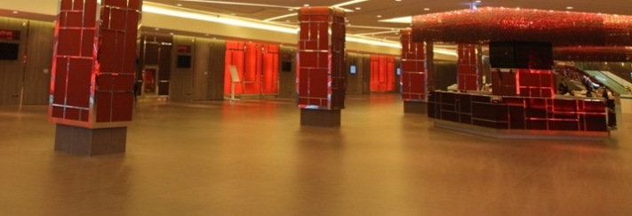
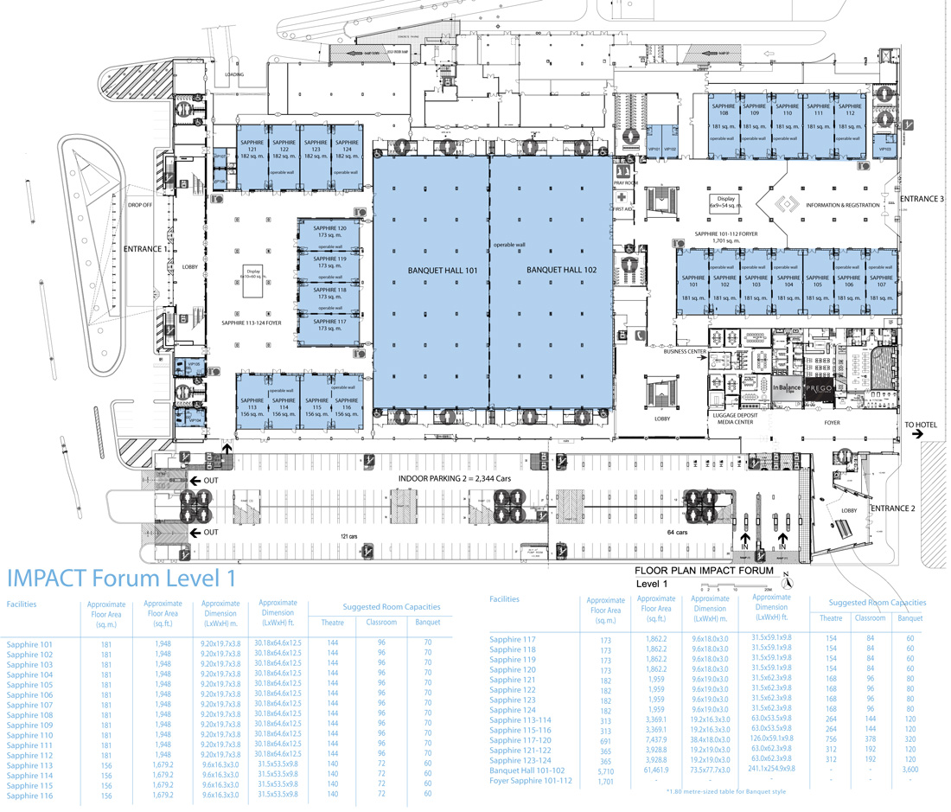
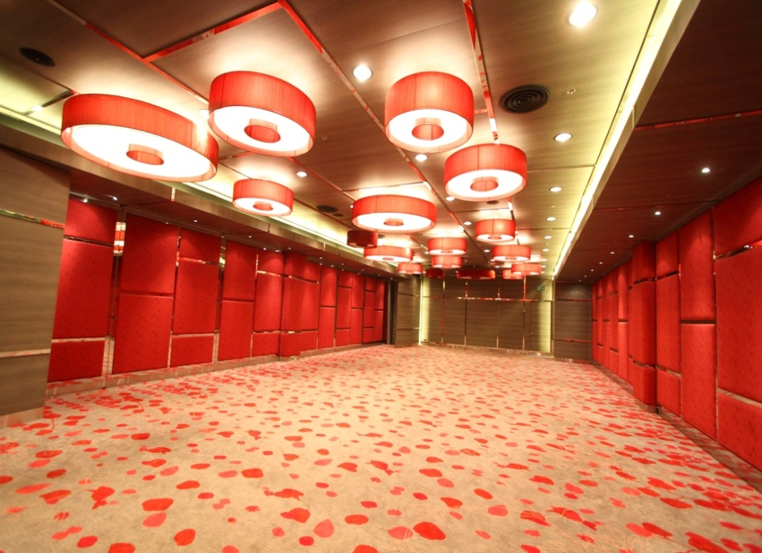
Area for Proceeding Office,
Speaker Ready
and Author Reception
Sapphire 101-102
Sapphire 101: Proceeding Office
Sapphire Foyer: Author Reception
Sapphire 102: Speaker Ready
IMPACT Forum Building (1st floor)
Sapphire 101
Area: 187 m²
Dimension: 9.5 m x 19.7 m x 3.8 m
Room capacities: 96 (Classroom)

Slide 2
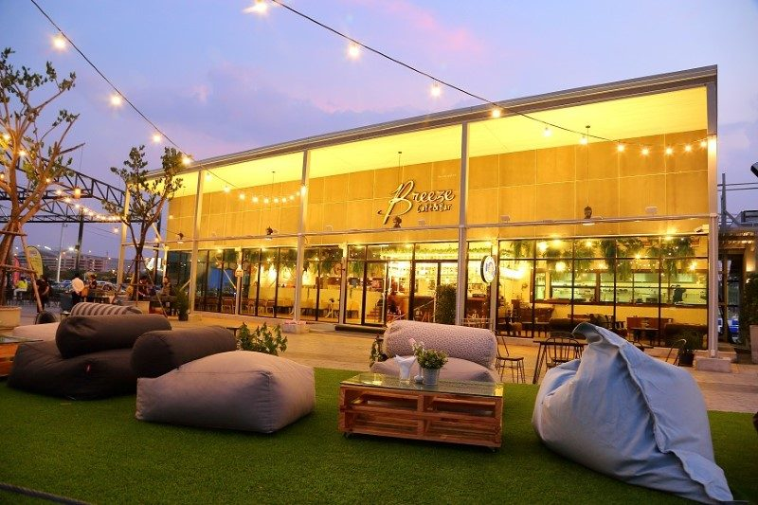
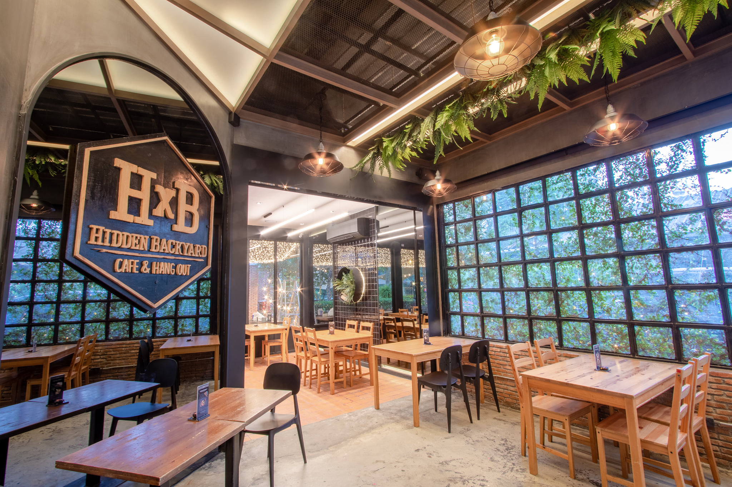
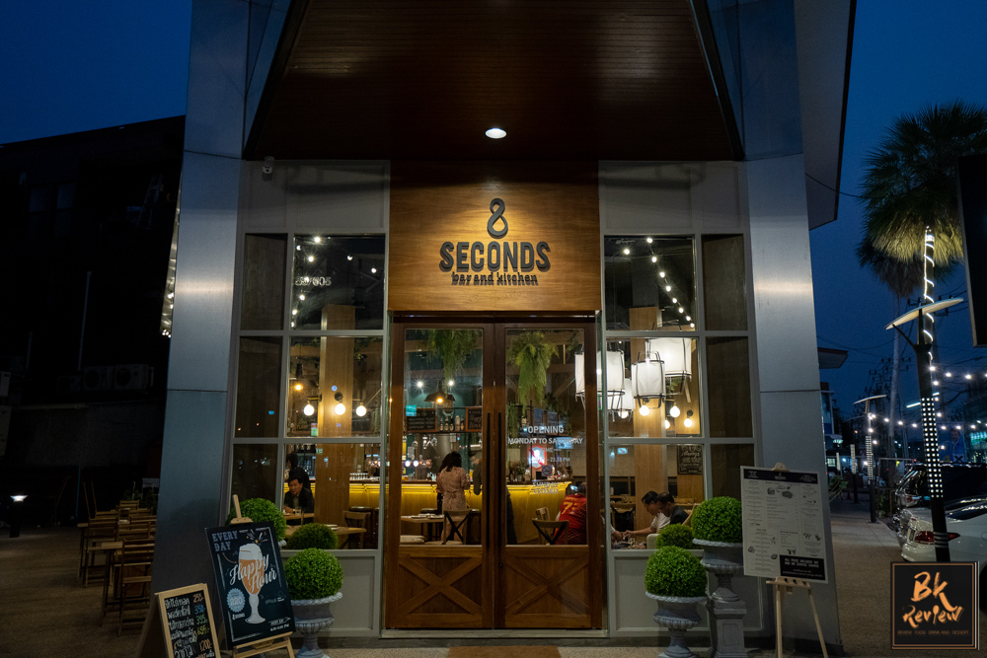
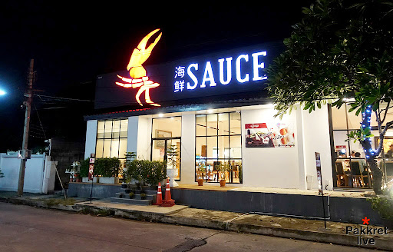
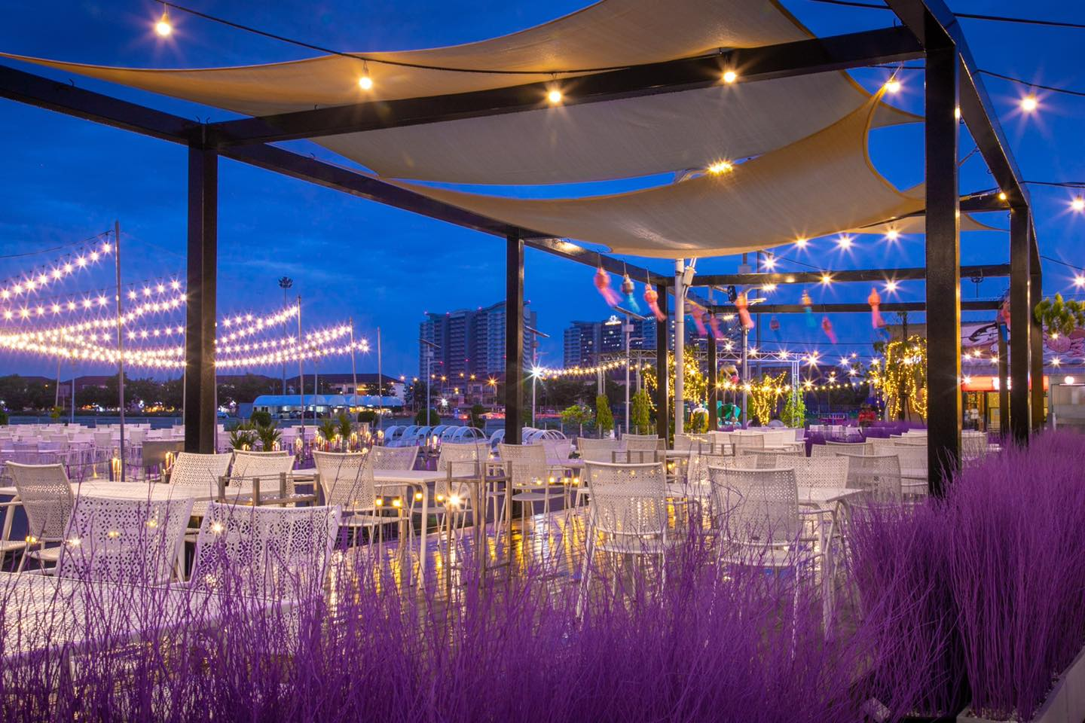
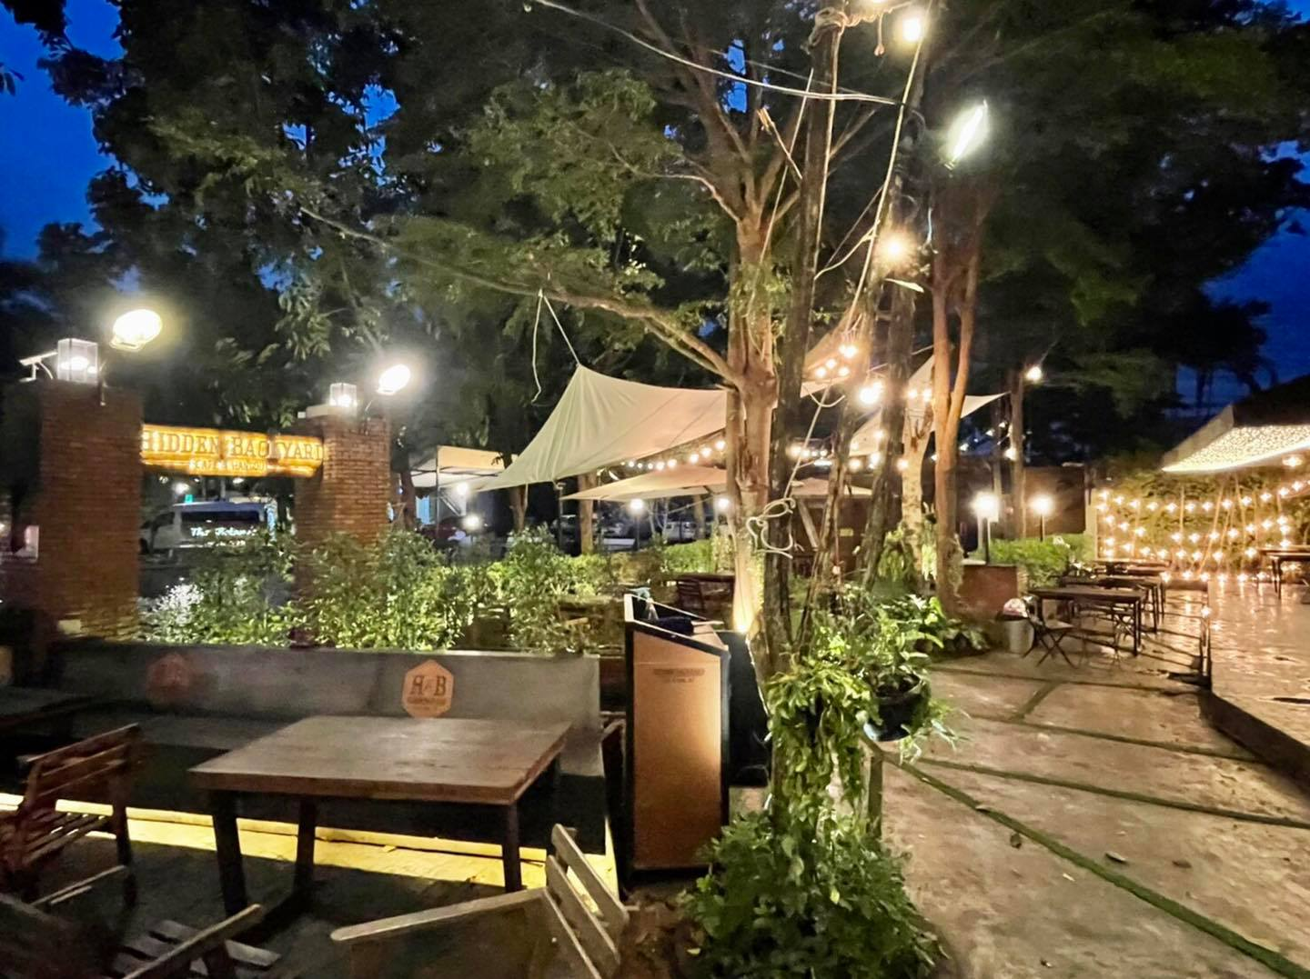
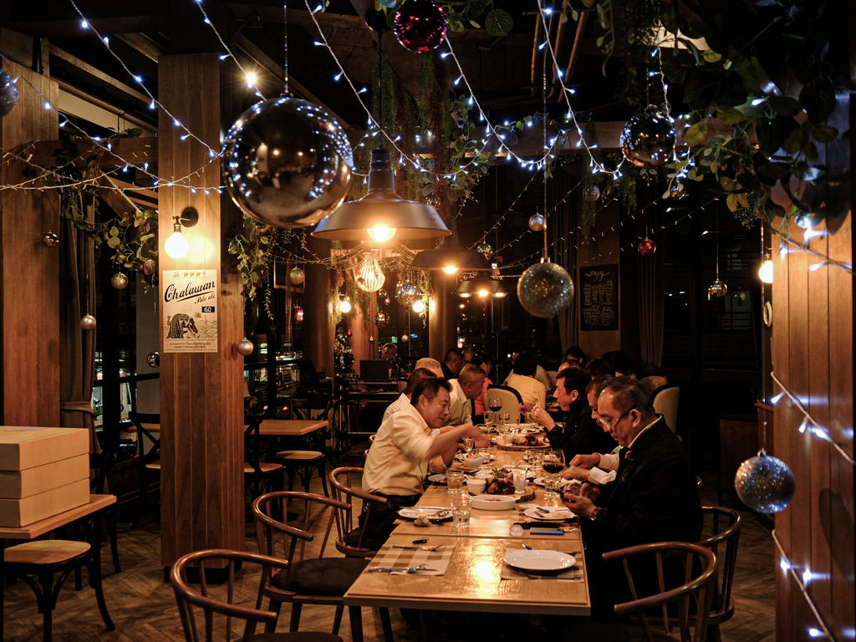
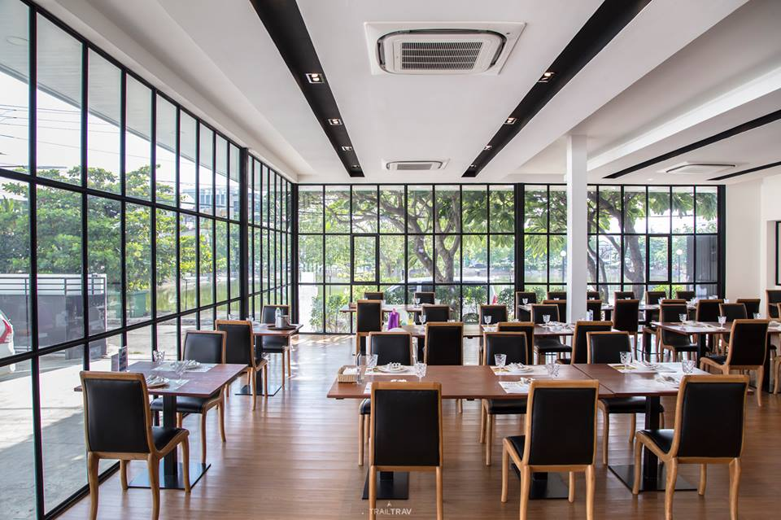
Possible choices for JACoW Team Reception
on Saturday 11th June 2022
Breeze Café & Bar
Hidden Backyard
8 Seconds Bar & Kitchen
SAUCE by Chef Wong

