Slide 1

JACoW Team Meeting 2021
Poster Session
Trieste Italy, 16th December 2021
17:30 – 18:30
https://www.jacow.org/JTM2021/PosterSession

Slide 2
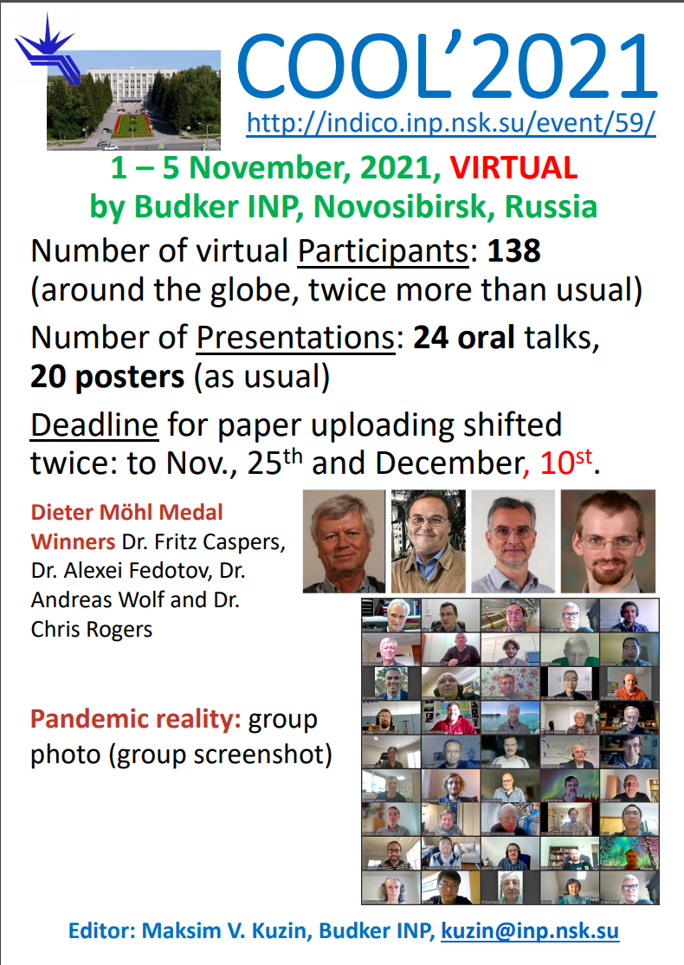
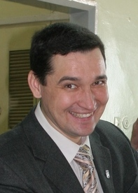

COOL'21
Chief Editor
Maxim Kuzin (BINP SB RAS)
kuzin@inp.nsk.su

Slide 3

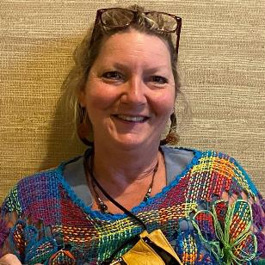
EBIST'22
Chief Editor
Jana Thomson (TRIUMF)
thomson@triumf.ca

Slide 4

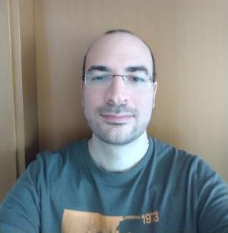
eeFact'22
Chief Editor
Massimiliano Iungo (INFN)
massimiliano.gualtiero.iungo@lnf.infn.it
1 of 3

Slide 5

eeFact'22
Chief Editor
Massimiliano Iungo (INF)
massimiliano.gualtiero.iungo@lnf.infn.it
2 of 3

Slide 6
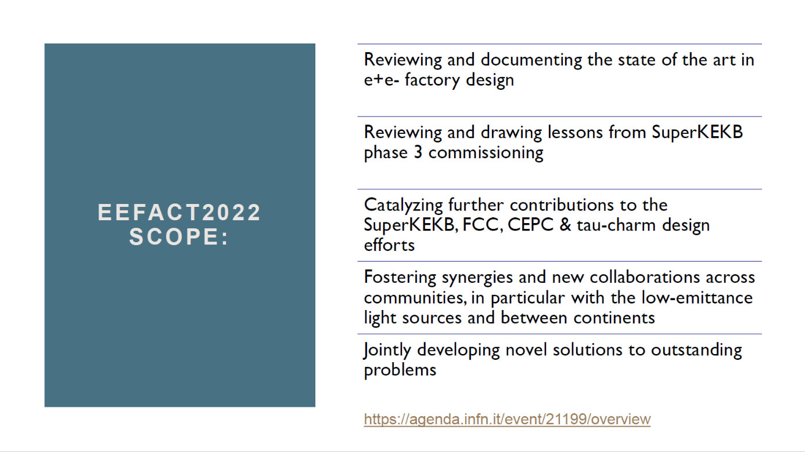
eeFact'22
Chief Editor
Massimiliano Iungo (INF)
massimiliano.gualtiero.iungo@lnf.infn.it
3 of 3

Slide 7
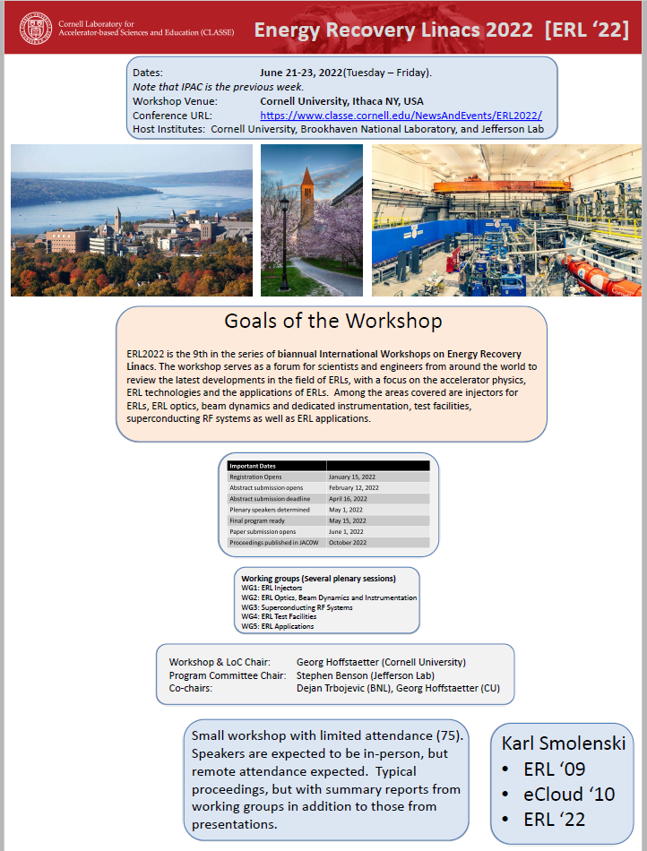
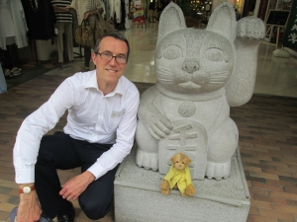
ERL'22
Chief Editor
Karl Smolenski(Cornell)
kws4@cornell.edu

Slide 8
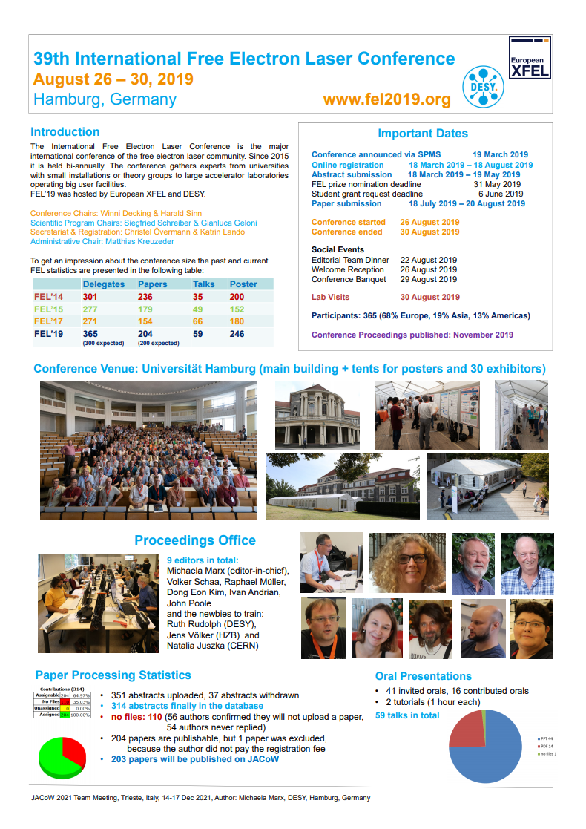
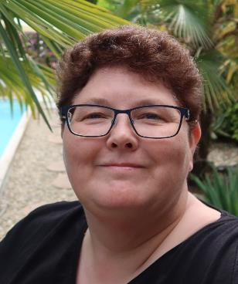
FEL'19
Chief Editor
Michaela Marx (DESY‘’)
michaela.marx@desy.de

Slide 9

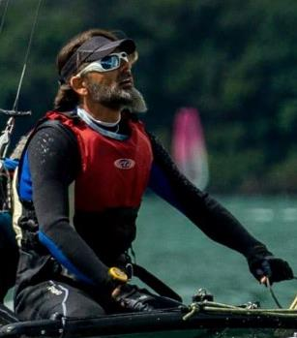
FEL’22
Chief Editor
Ivan Andrian (Elettra)
ivan.andrian@elettra.eu

Slide 10
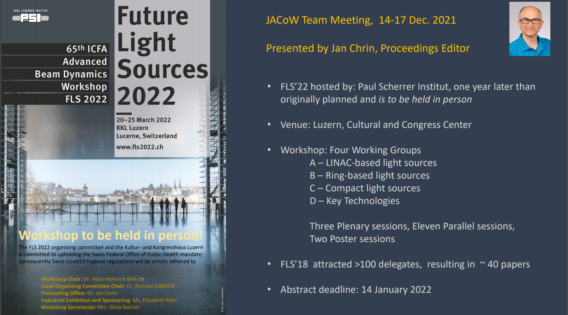
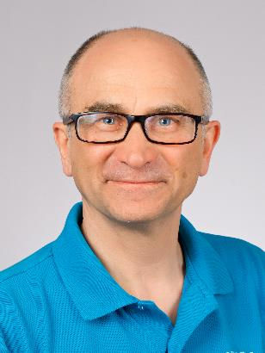
FLS’22
Chief Editor
Jan Chrin (PSI)
jan.chrin@psi.ch

Slide 11

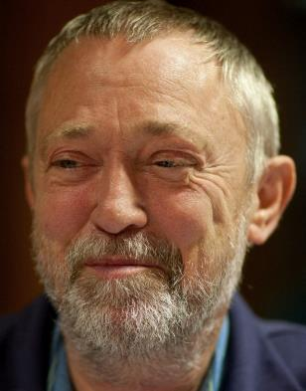
HB’21
Chief Editor
Volker Schaa (GSI)
v.r.w.schaa@gsi.de

Slide 12

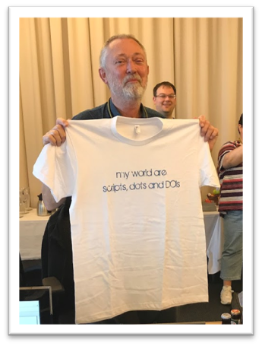
HIAT’22
Chief Editor
Volker Schaa (GSI)
v.r.w.schaa@gsi.de

Slide 13
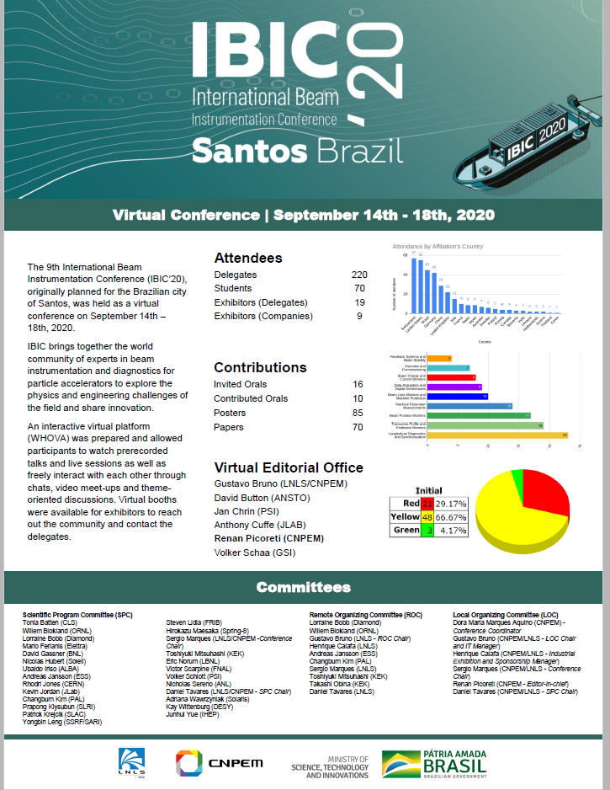
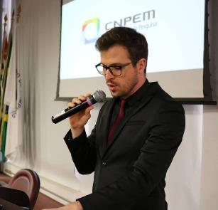
IBIC’20
Chief Editor
Renan Picoreti (LNLS)
renan.picoreti@cnpem.br

Slide 14
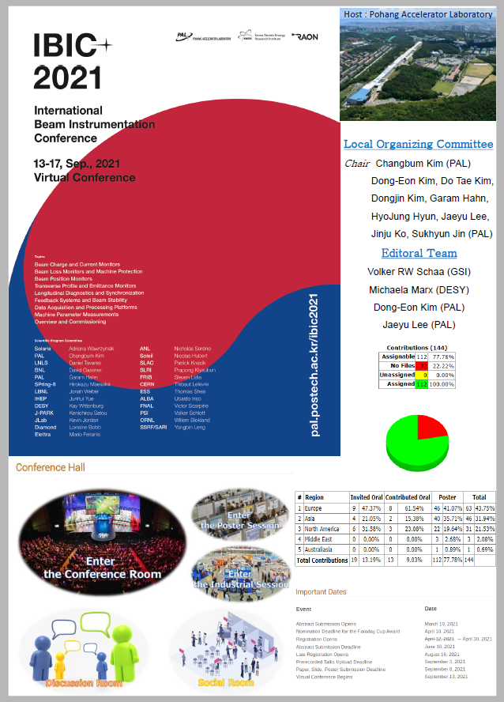
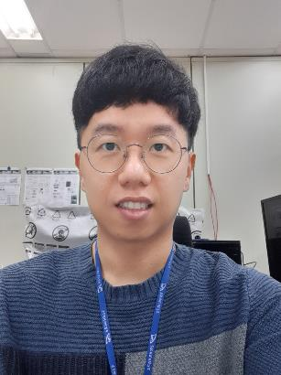
IBIC’21
Chief Editor
Jaeyu Lee (PAL)
eju@postech.ac.kr

Slide 15

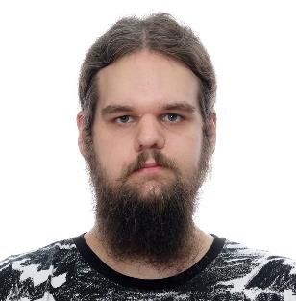
IBIC’22
Chief Editor
Grzegorz Kowalski (SOLARIS)
g.kowalski@uj.edu.pl

Slide 16
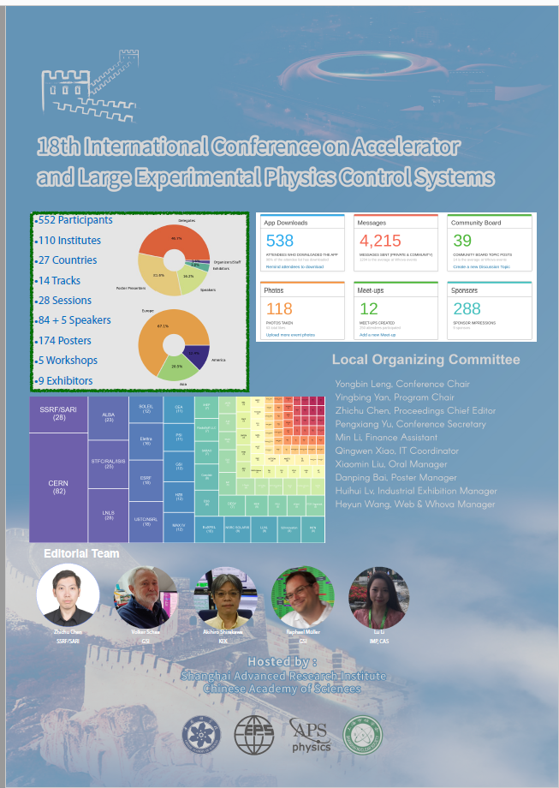
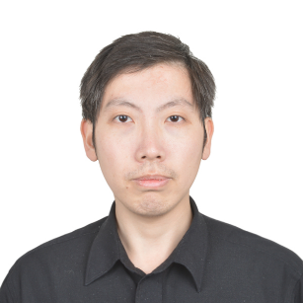
ICALEPCS'21
Chief Editor
Zhichu Chen [Ross] (SARI)
chenzhichu@zjlab.org.cn

Slide 17
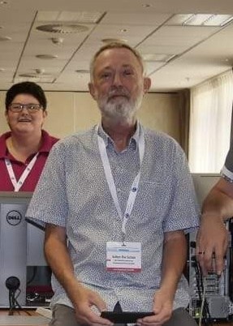
ICAP’22
Chief Editor
Volker Schaa (GSI)
v.r.w.schaa@gsi.de

Slide 18
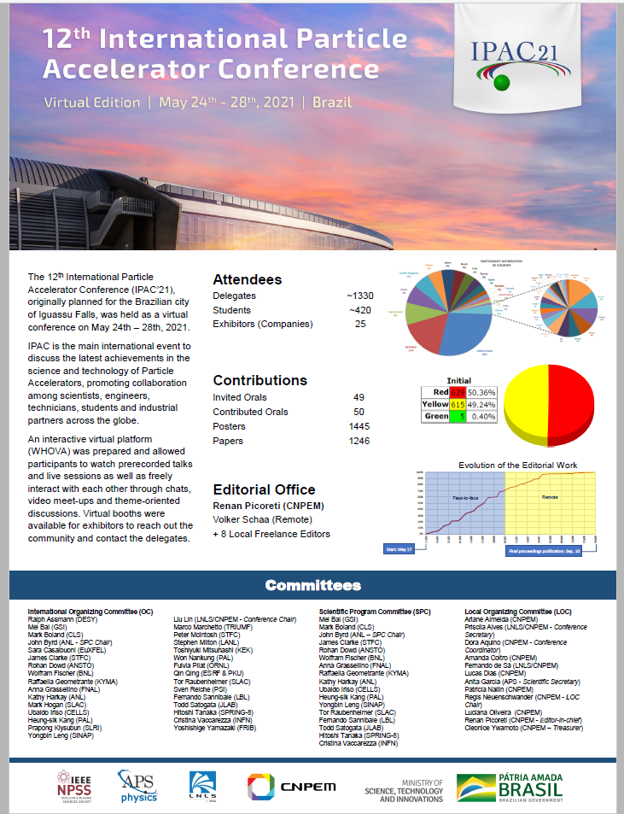
IPAC’21
Chief Editor
Renan Picoreti (LNLS)
renan.picoreti@cnpem.br

Slide 19

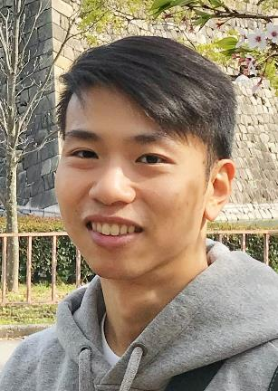
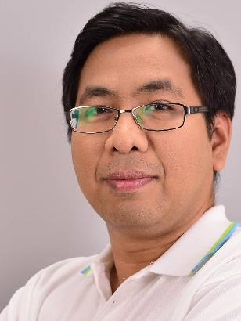
IPAC’22
Chief Editor
Thakonwat Chanwattana (SLRI)
thakonwat@slri.or.th
Nawin Juntong (SLRI)
nawin@slri.or.th
1 of 3

Slide 20
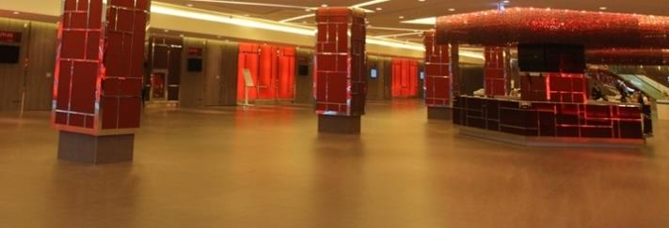
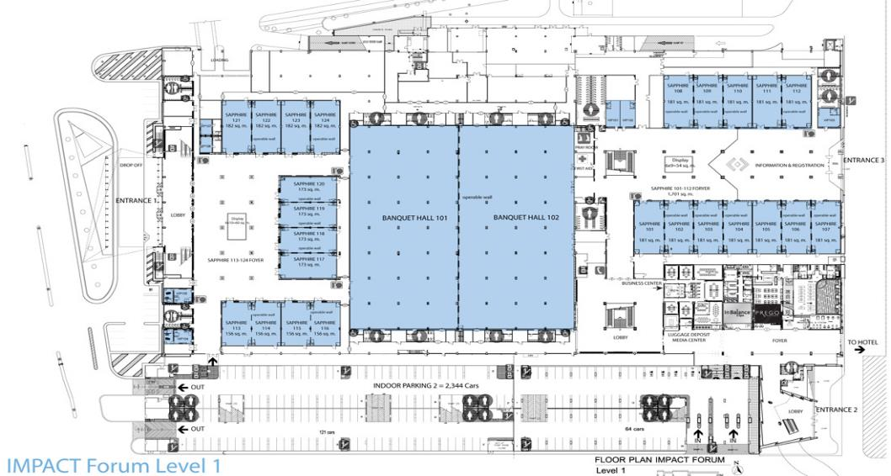
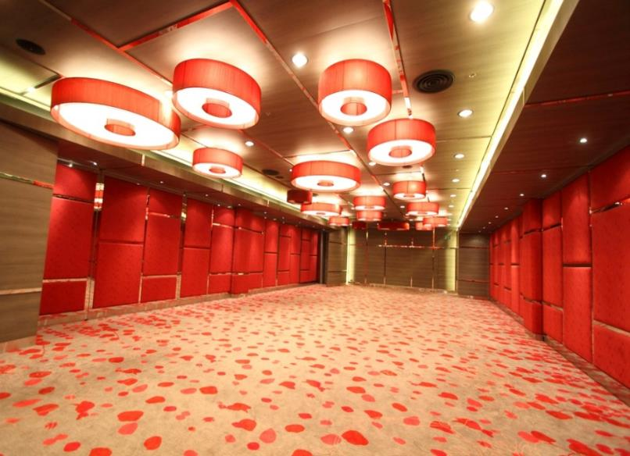
Area for Proceeding Office,
Speaker Ready
and Author Reception
Sapphire 101-102
Sapphire 101: Proceeding Office
Sapphire Foyer: Author Reception
Sapphire 102: Speaker Ready
IMPACT Forum Building (1st floor)
Sapphire 101
Area: 187 m²
Dimension: 9.5 m x 19.7 m x 3.8 m
Room capacities: 96 (Classroom)
2 of 3

Slide 21
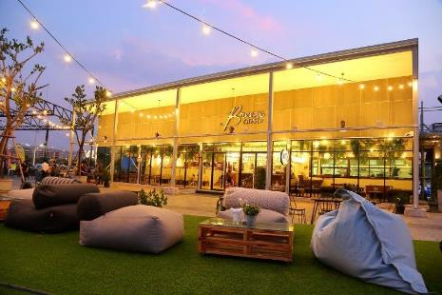


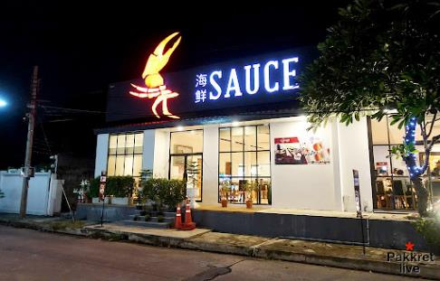

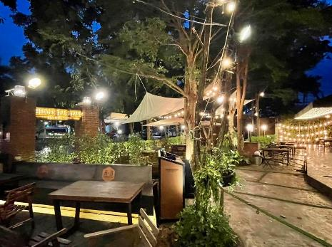
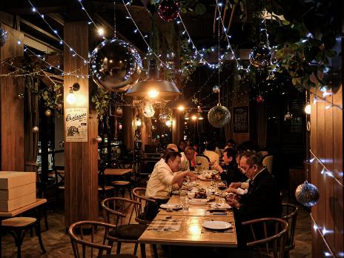
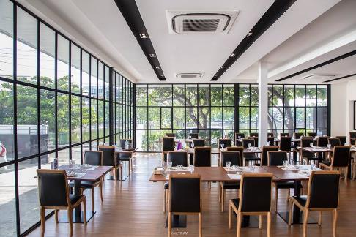
Possible choices for JACoW Team Reception
on Saturday 11th June 2022
Breeze Café & Bar
Hidden Backyard
8 Seconds Bar & Kitchen
SAUCE by Chef Wong
3 of 3

Slide 22

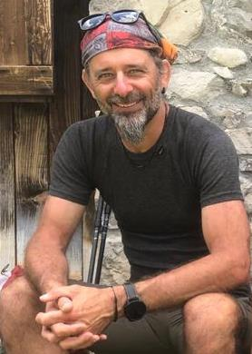
IPAC’23
Chief Editor
Ivan Andrian (Elettra)
ivan.andrian@elettra.eu
1 of 4

Slide 23
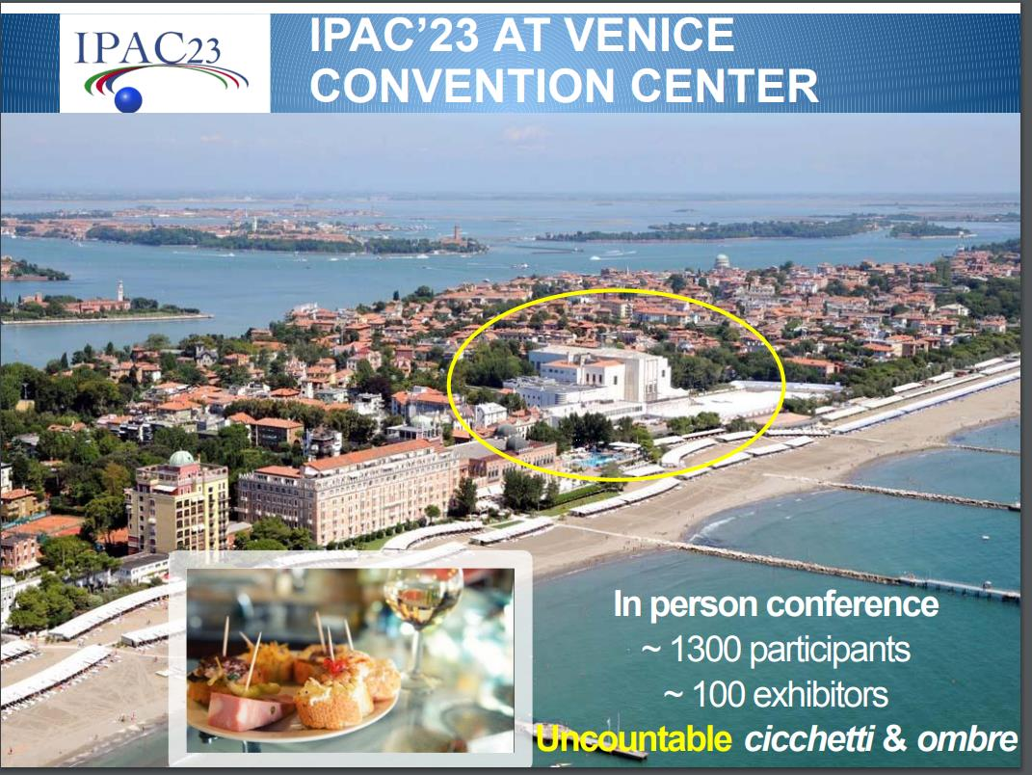
IPAC’23
Chief Editor
Ivan Andrian (Elettra)
ivan.andrian@elettra.eu
2 of 4

Slide 24
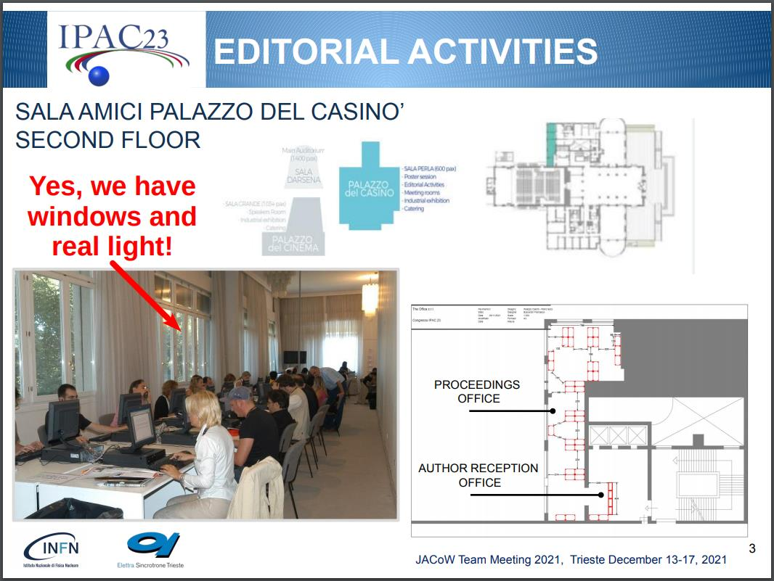
IPAC’23
Chief Editor
Ivan Andrian (Elettra)
ivan.andrian@elettra.eu
3 of 4

Slide 25

IPAC’23
Chief Editor
Ivan Andrian (Elettra)
ivan.andrian@elettra.eu
4 of 4

Slide 26
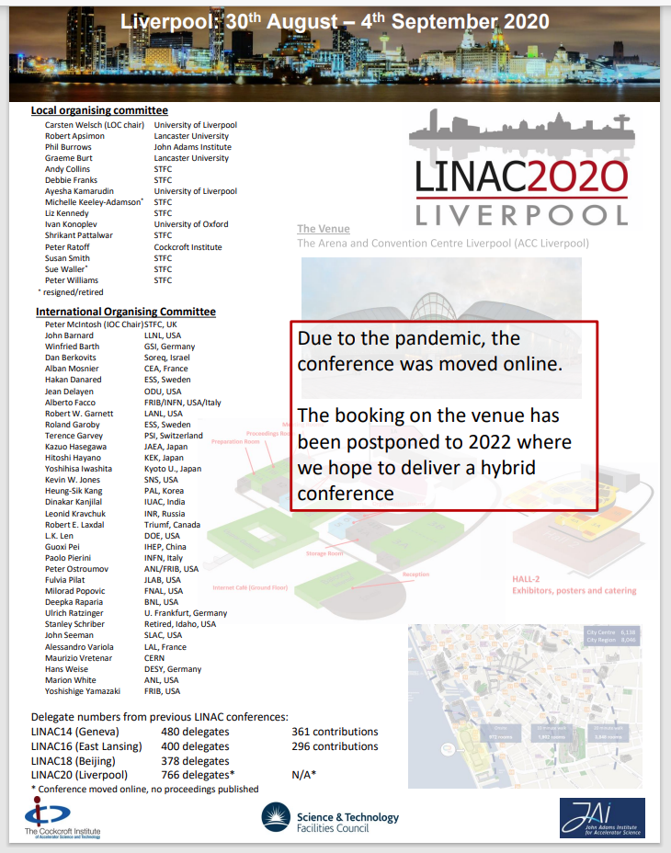
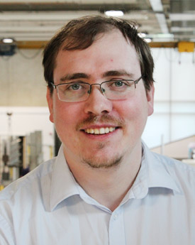
LINAC’20
Chief Editor
Robert Apsimon (Cockcroft Institute)
r.apsimon@lancaster.ac.uk

Slide 27
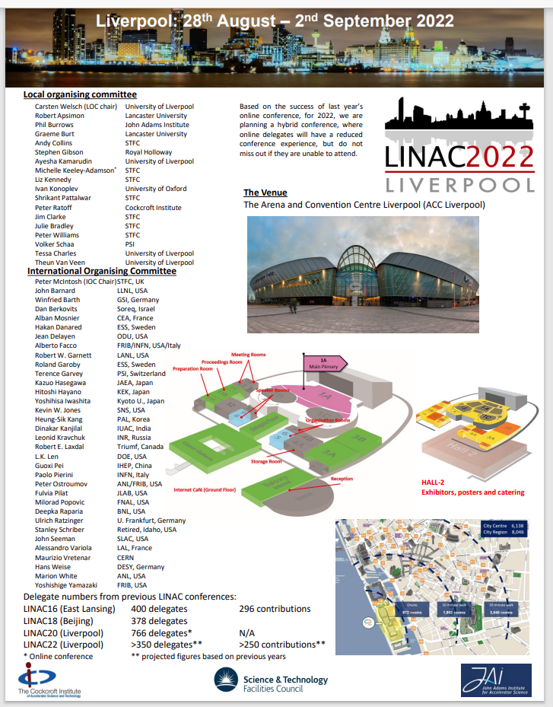
LINAC’22
Chief Editor
Robert Apsimon (Cockcroft Institute)
r.apsimon@lancaster.ac.uk

Slide 28
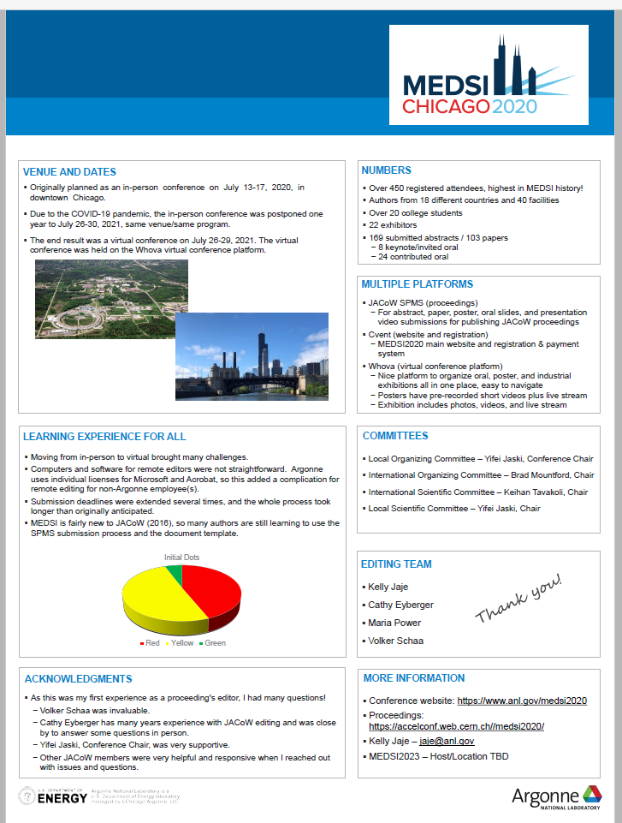
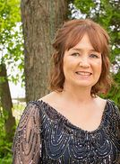
MEDSI'20
Chief Editor
Kelly Jaje (ANL)
jaje@anl.gov

Slide 29
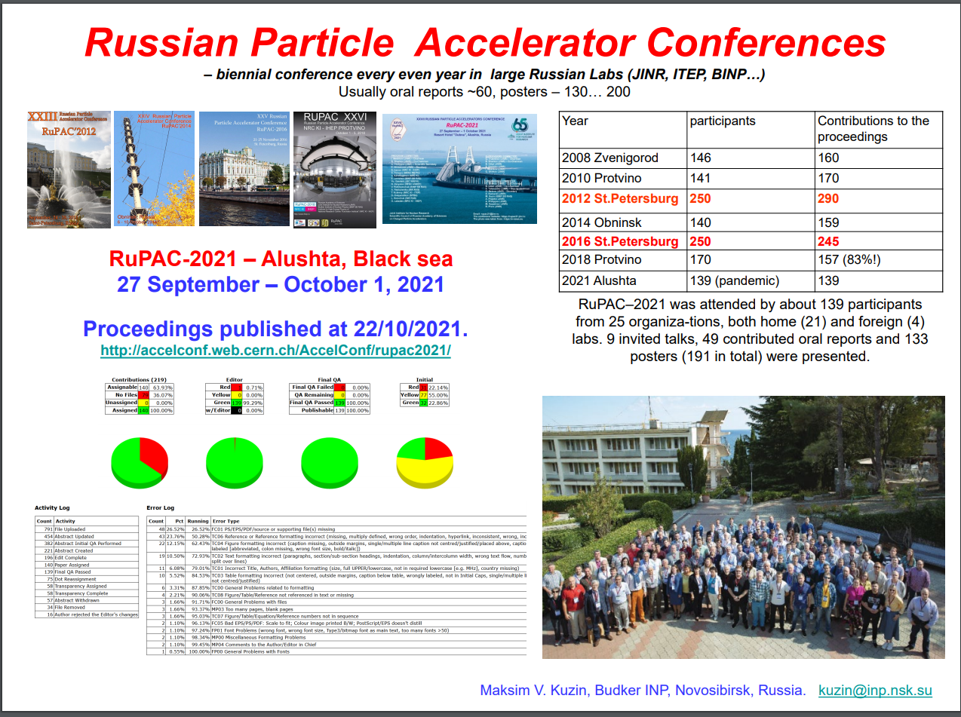
RuPAC’21
Chief Editor
Maxim Kuzin (BINP SB RAS)
kuzin@inp.nsk.su

